Slide 1
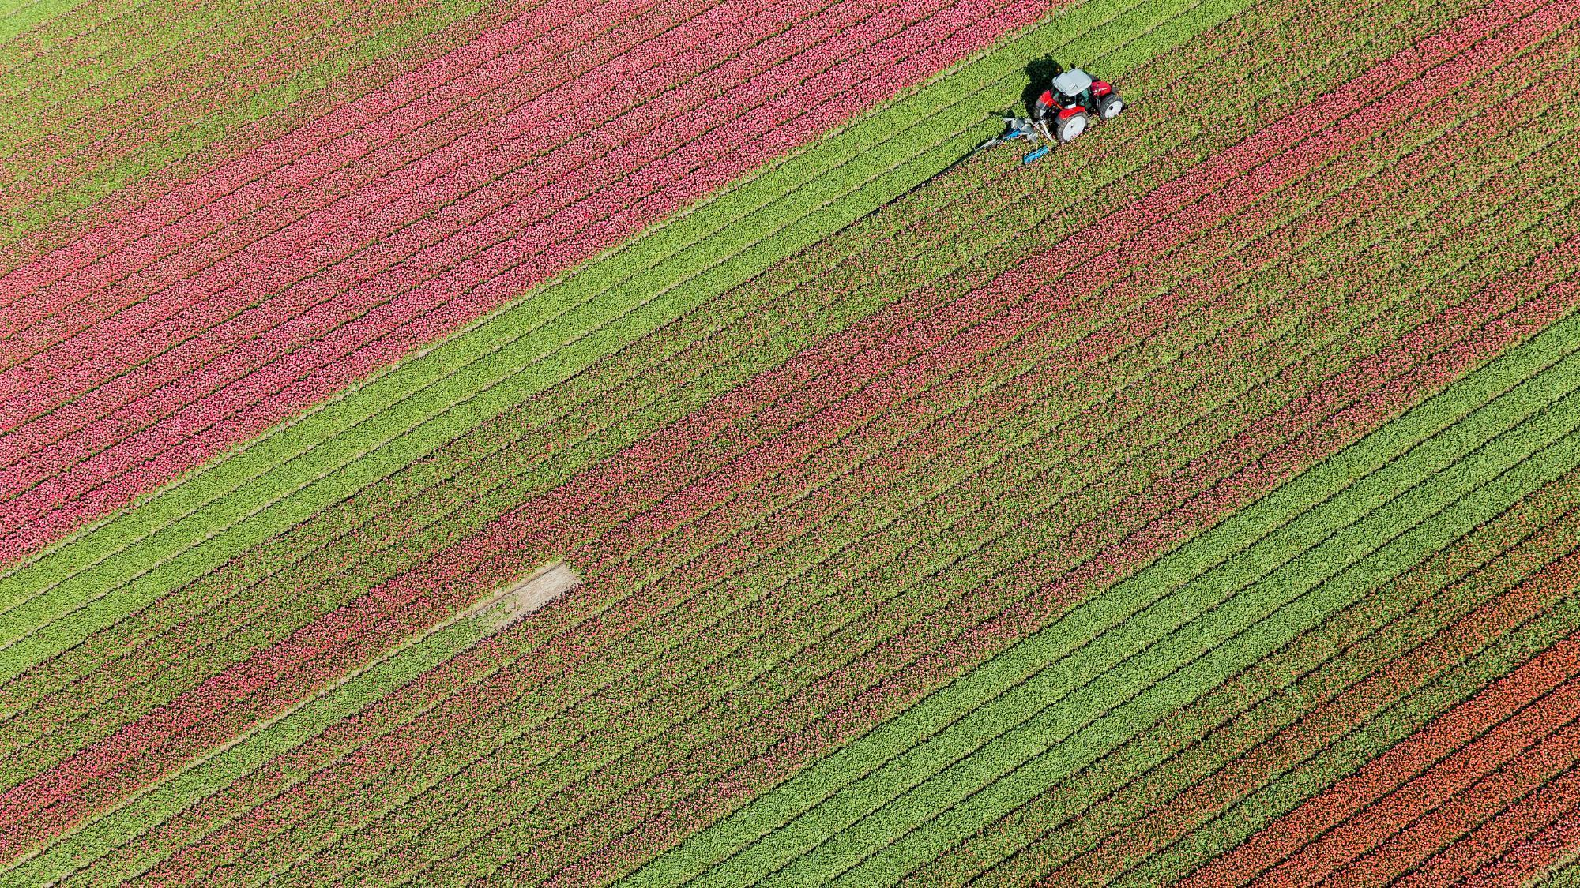
AI Farming
By @Kanajariya Brothers

Slide 2

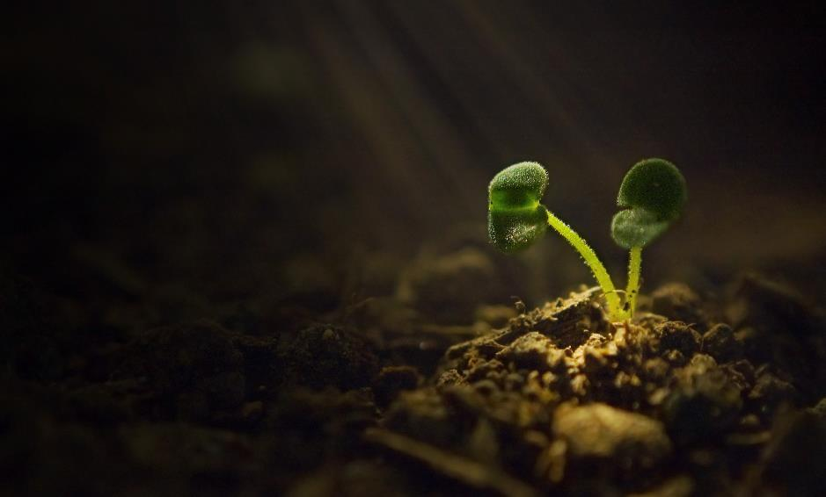
How to do Farming in 21st Century
Why Indian farmers are poor?
What are the main problems of farmers in India
Types of farming in India
Importance of agriculture in India
What is smart agriculture system?

Slide 3

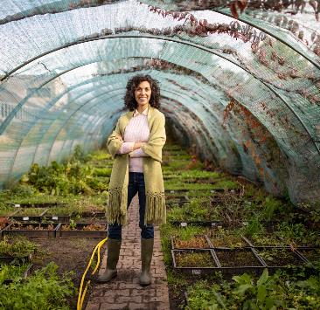
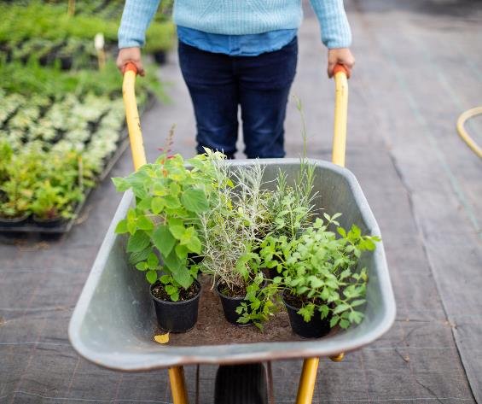
Introduction
Agriculture plays a vital role in Indian economy. Over 70% of the rural households depend on agriculture. Agriculture is an important sector of Indian economy as it contributes about 17% to the total GDP and Provides employment to over 60% of the population.

Slide 4
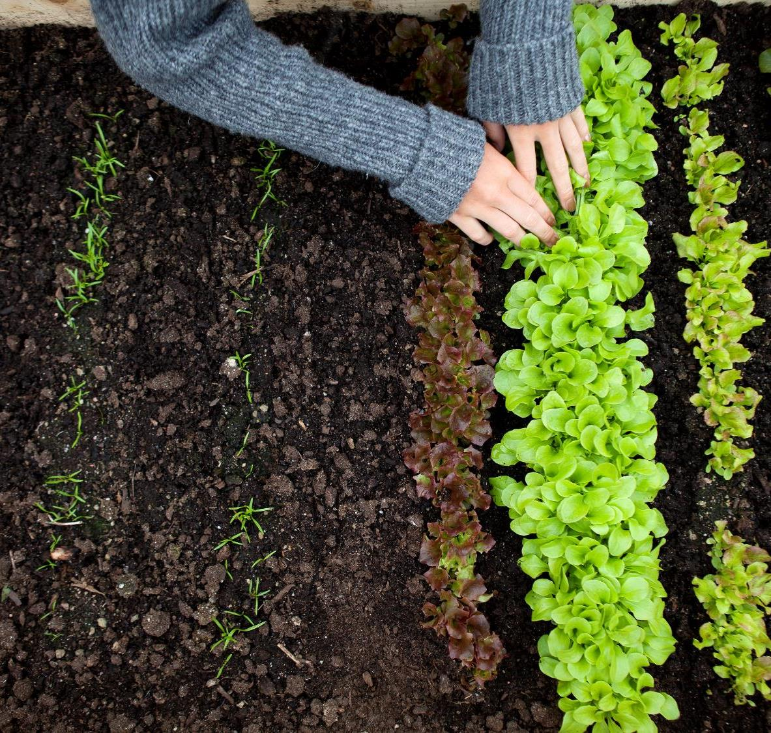
Topic one
Subtitle

Slide 5

Why Indian farmers are poor?
Majority of farmers are poor with low education, vulnerable to physical and economic risks, and financially stressed with zero savings or worse, indebtedness. As agriculture is in itself a risky financial and social enterprise, the pressure for the farming families to stay afloat is saddling.
With using VFA farmers can easily track their crop and Plant growth, By knowing the crop details and giving farmers a right education they can increase their revenue from farming

Slide 6


What are the main problems of Farmers in India?
Less Education
Less Use of Modern Farming Equipment
Over Dependence on Traditional Crops

Slide 7

The way to get started is to quit talking and begin doing.
Walt Disney

Slide 8

Timeline
Title
Title
If you don’t see the Notes pane or it is completely minimized, click Notes on the task bar across the bottom of the PowerPoint window.
To display Presenter view, in Slide Show view, on the control bar at the bottom left select the three dots, and then Show Presenter View.
Title
During your presentation, the speaker notes are visible on your monitor, but aren't visible to the audience.
To start a presentation, go to the Slide Show tab, and select From Beginning.
The Notes pane is a box that appears below each slide. Tap it to add notes.

Slide 9
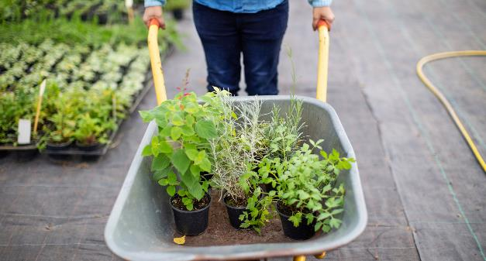
Two Content
Subtitle
Subtitle
Add text, images, art, and videos.
Add transitions, animations, and motion.
Save to OneDrive, to get to your presentations from your computer, tablet, or phone.
Open the Design Ideas pane for instant slide makeovers.
When we have design ideas, we’ll show them to you right there.

Slide 10
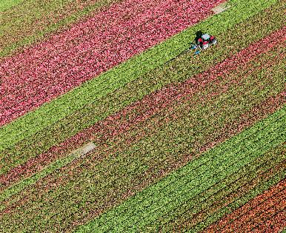
Three Content
Subtitle
Subtitle
Subtitle
Add text, images, art, and videos.
Add transitions, animations, and motion.
Save to OneDrive, to get to your presentations from your computer, tablet, or phone.
Open the Design Ideas pane for instant slide makeovers.
When we have design ideas, we’ll show them to you right there.
This PowerPoint theme uses its own unique set of colors, fonts, and effects to create the overall look and feel of these slides.
PowerPoint has tons of themes to give your presentation just the right personality.

Slide 11
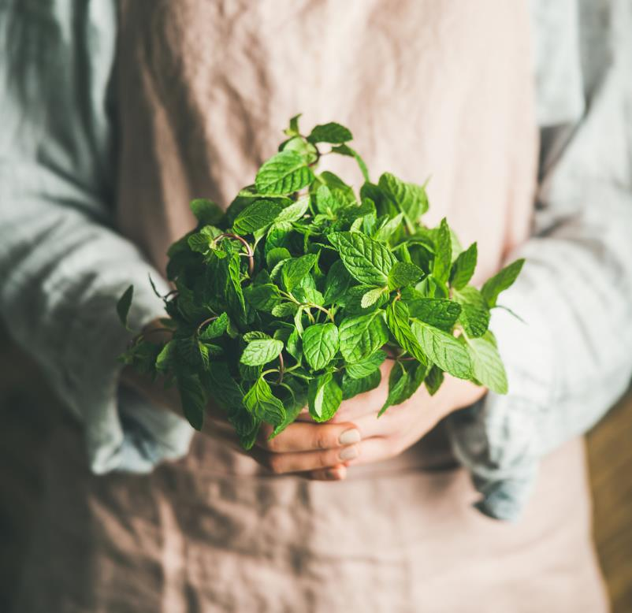
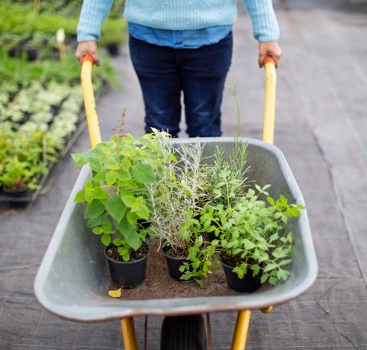
Summary
With PowerPoint, you can create presentations and share your work with others, wherever they are. Type the text you want here to get started. You can also add images, art, and videos on this template. Save to OneDrive and access your presentations from your computer, tablet, or phone.

Slide 12

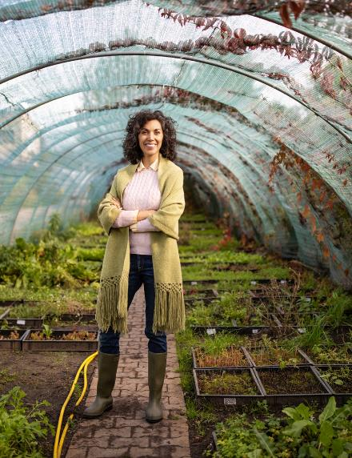
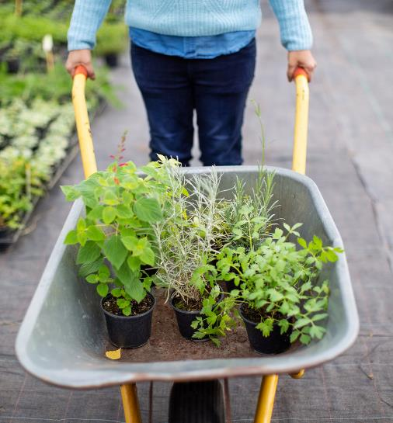

Thank You
Presenter Name
Email
Website

